Slide 1
Cleantech Nanofiltration for Recycling Used Lubrication Oils

Slide 2
Used Lubricating Oil is Hazardous Waste
Contamination: Improper disposal leads to the contamination of soil, water bodies, and the air.
Bioaccumulation: Some contaminants in used oil accumulate in the food chain, magnifying their impact as they move up through different organisms.
Health Risks: Exposure to these hazardous elements results in adverse health effects - carcinogenicity, developmental issues, and organ damage.
Regulatory Classification: Regulatory bodies classify used oil as hazardous waste due to its potential harm to the environment and human health.

Slide 3
Used Lube Oil Recycling Technology
Current oil recycling technology poses environmental challenges due to energy-intensive refining processes that generate greenhouse gas emissions and pollutants.
Despite energy recovery efforts, recycling oil remains less efficient than producing new oil, raising concerns about cost-effectiveness.
Solution - MemPore has developed an eco-friendly, energy-efficient, and economically viable oil recycling solutions.

Slide 4
Solution - MemPore’s Unique Membrane Technology
MemPore's unique membrane technology produces high quality base oil while offering the following advantages over current technology:
Smaller footprint
Lower capital and operating costs
Stops and starts on demand – minimal downtime.
Significant environmental benefits

Slide 5
Process
Pre-treatment removes contaminants such as water, glycol, alcohol, and emulsions
Nanofiltration is the heart of the system and incorporates a precision membrane that separates the pre-treated oil from undesirable non-hydrocarbon substances at the molecular level, based on their molecular weights
Polishing removes residual molecules that affect color and odor

Slide 6
Membranes
Thermoplastic polymer 0.003 in. thick
Porosity controlled to molecular size
Durable 12+ months operating life
Trade secret membrane casting process with over 20 variables

Slide 7
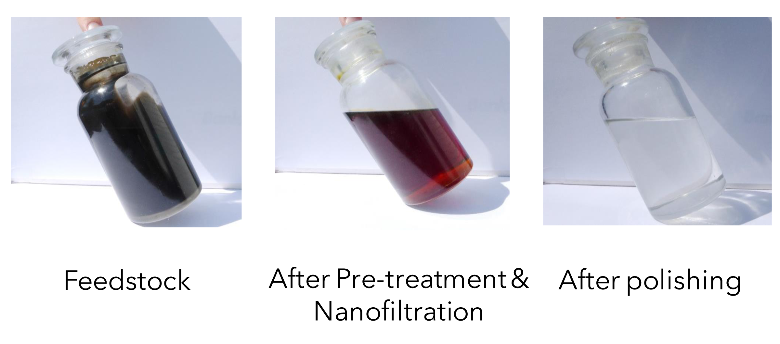
Samples

Slide 8
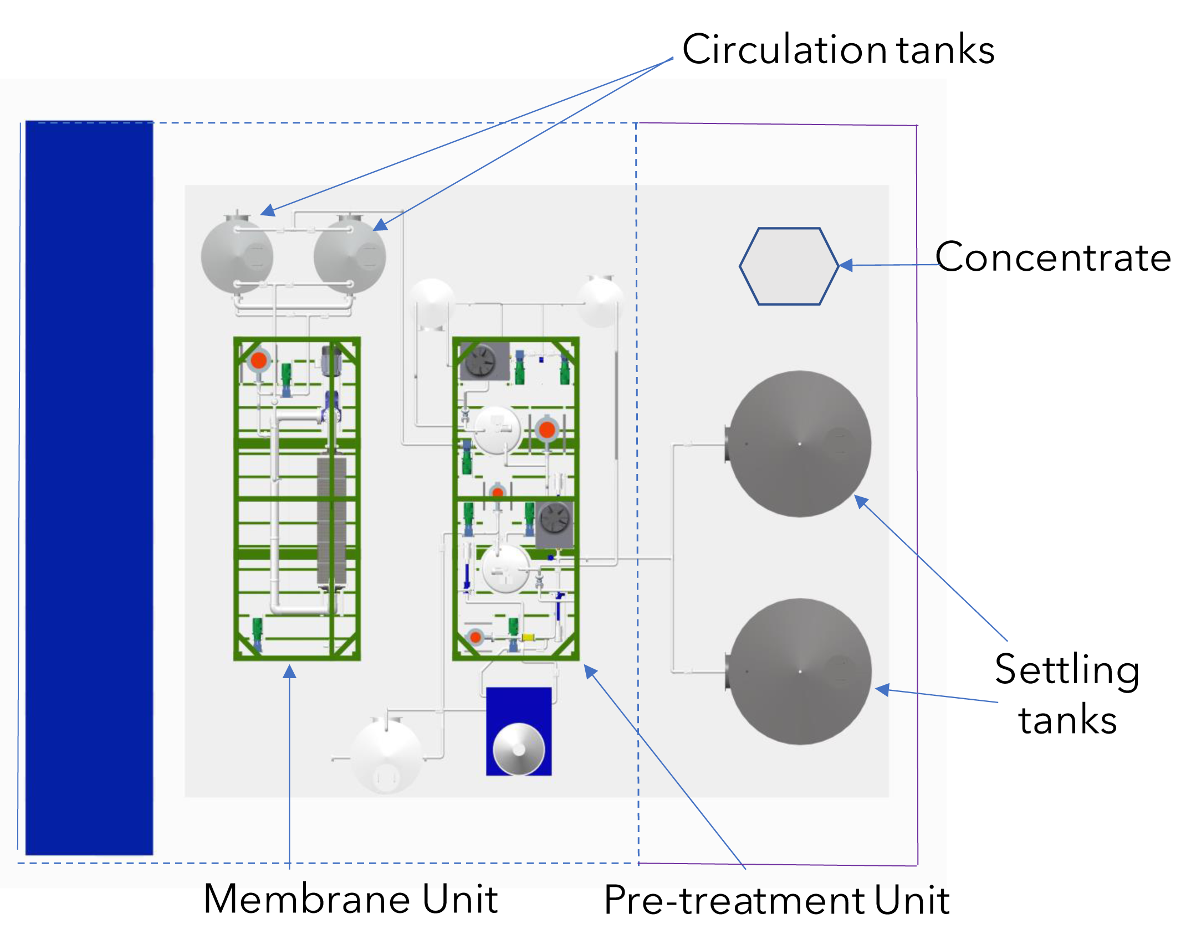
Example of System Layout (total area 2500 sq.ft. - covered area 1000 sq.ft.)

Slide 9
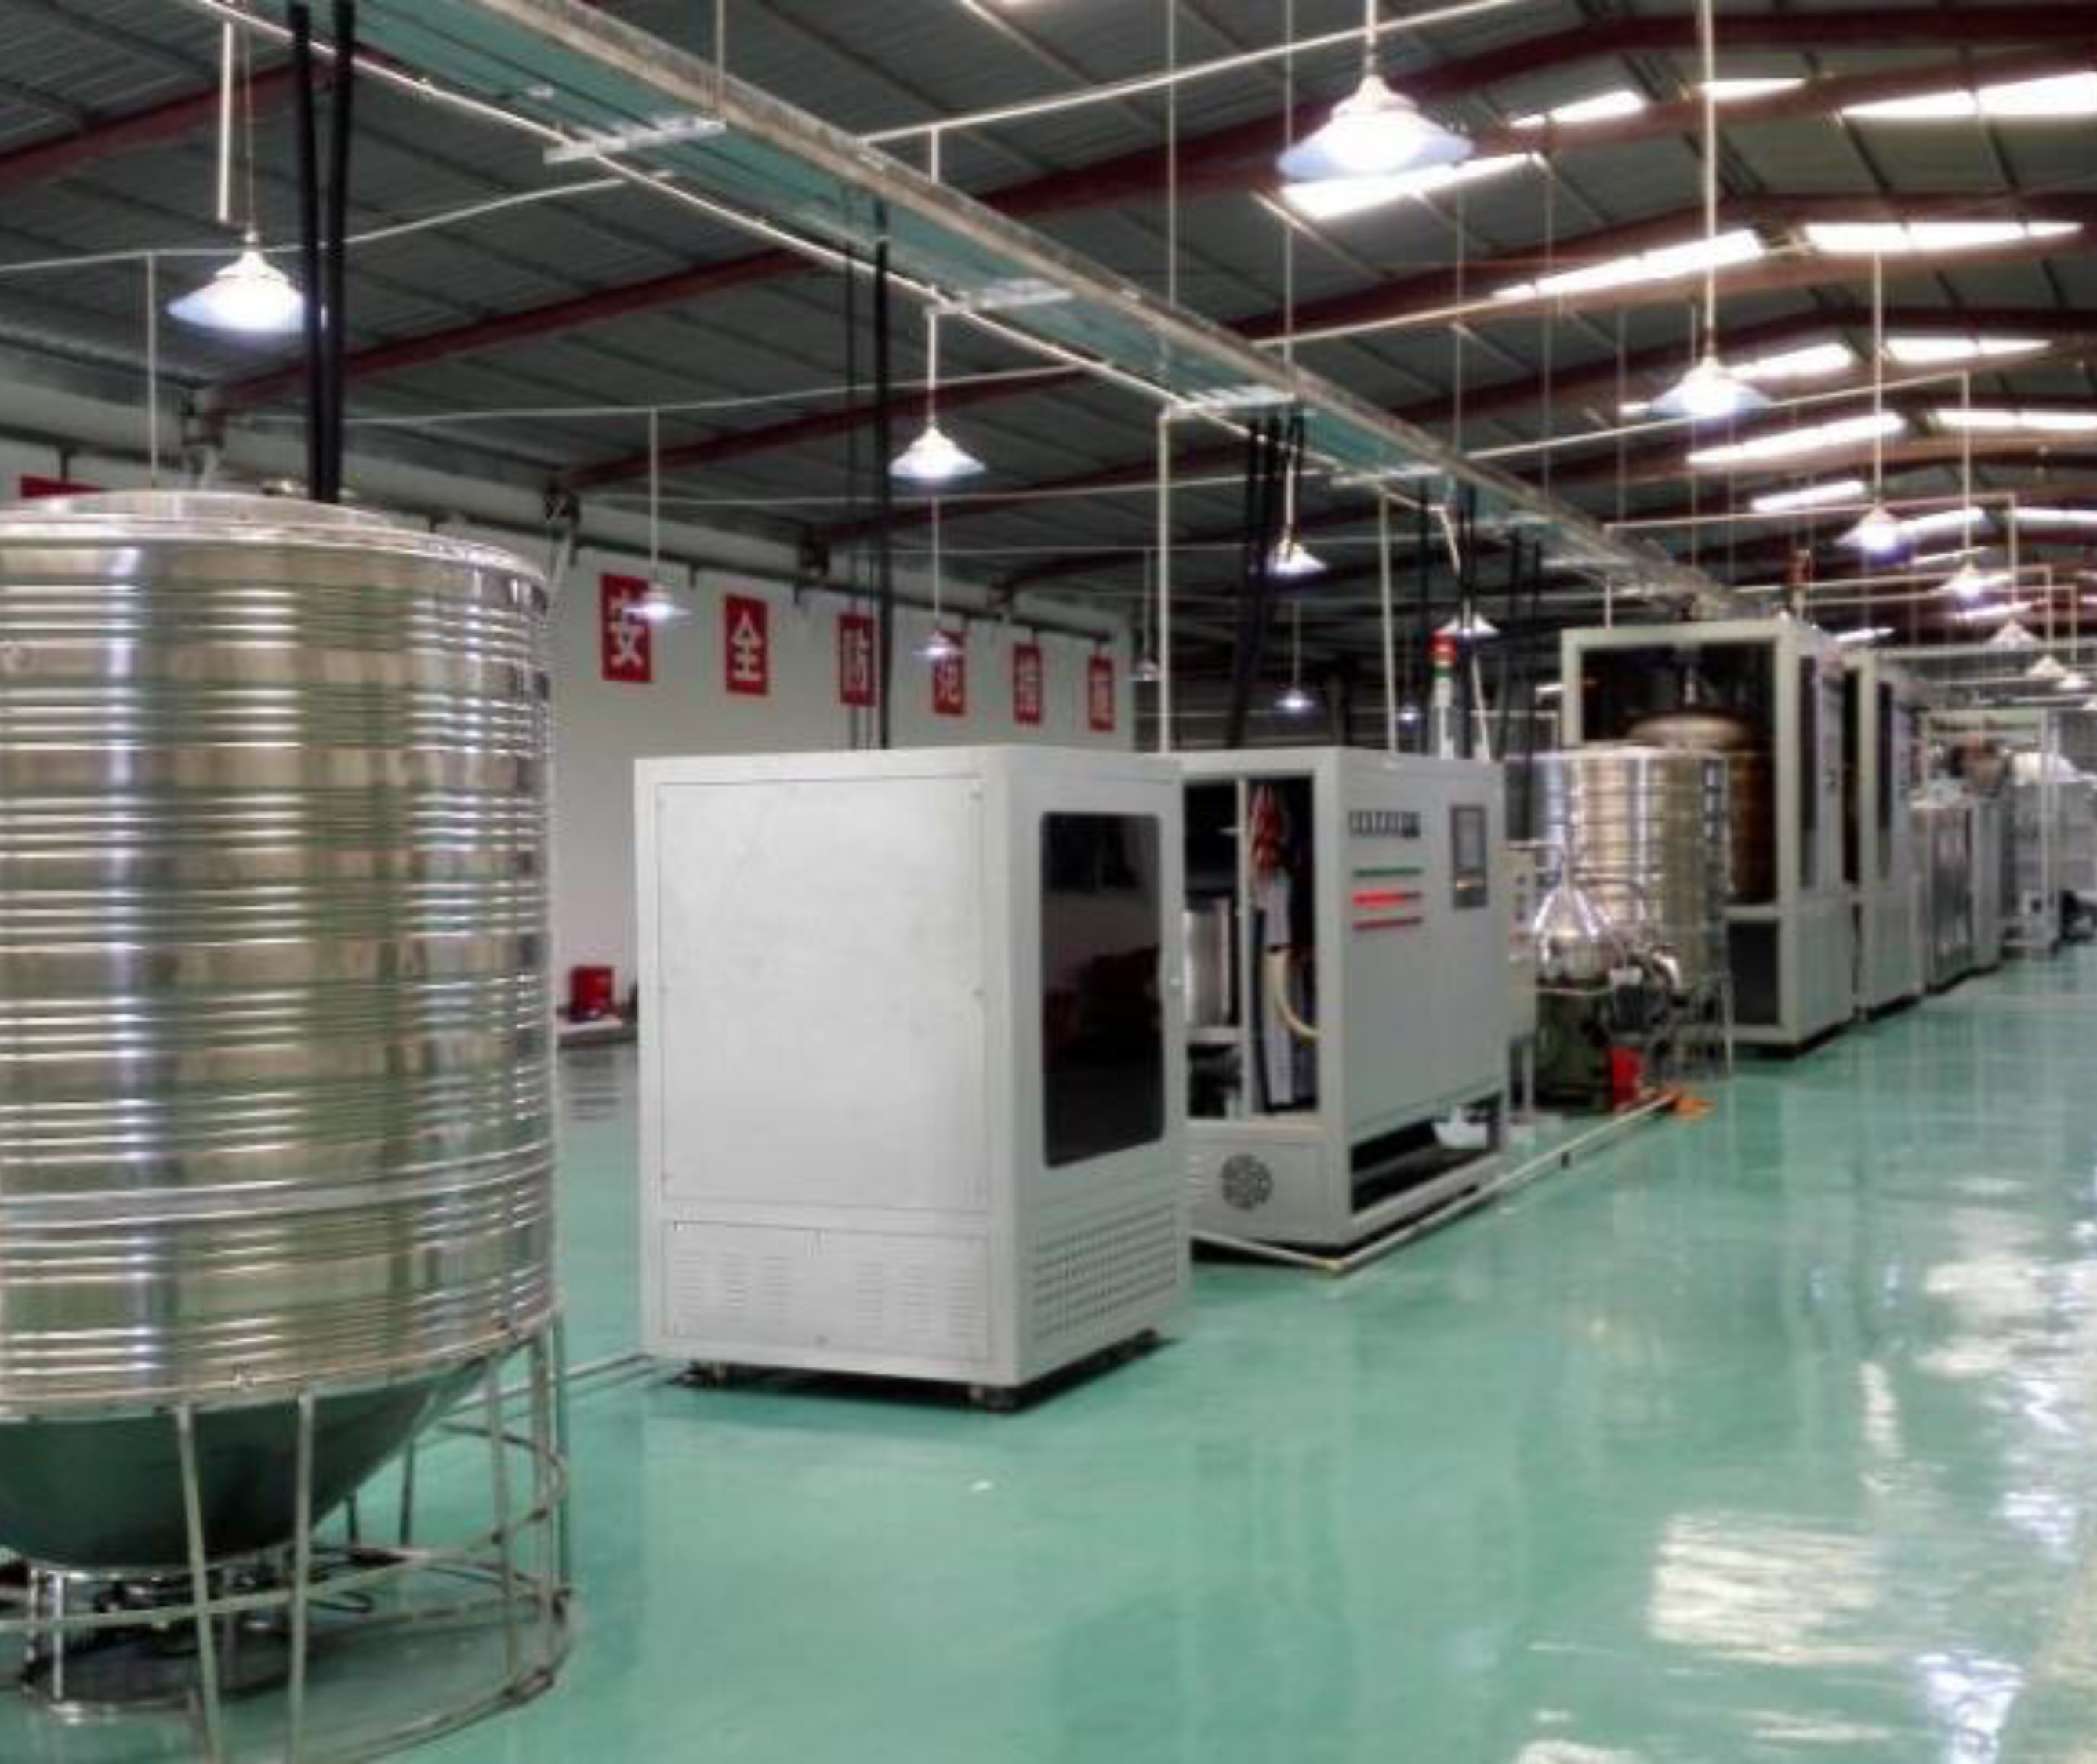
Typical MemPore Used Lubricating Oil Recycling Facility

Slide 10
Profitability Example
System Purchase Price $2.8 M
• 300 Plate System
• Processes up to 8.5 M Litres of feed per year
• 65% recovery @ 5.5 M Litres
• 330 days of operation per year
Base Oil Sales (70% recovery) $2.75 M
• 5.5 M x $0.50 per Litre = $2.75 M
Yearly Operating Costs to Customer $0.4 M
• Electricity @ 7.3 cents per KwH - $95 K
• Annual Service / Licence Fee - $305 K
Margin/yr $2.35 M
Payback 15 months

